Slide 1
4

Slide 2
Analyzing the Marketing Environment
Topic Outline
The Company’s Microenvironment
The Company’s Macroenvironemnt
Responding to the Marketing Environment

Slide 3
Chapter Four
Managing Marketing Information to Gain Customer Insights

Slide 4
Learning Objectives
4 – Mktg Info and Customer Insights
Marketing Information and Customer Insights
Assessing Marketing Information Needs
Developing Marketing Information
Marketing Research
Analyzing Marketing Information
Distributing and Using Marketing Information
Other Marketing Information Considerations

Slide 5


Marketing Information and Customer Insights
Customer Insights are:
Fresh and deep insights into customers needs and wants
Difficult to obtain
  Not obvious
  Customer’s unsure of their behavior
Not derived from more information but better information and more effective use of existing information
Notes:
Note to instructor
This Web link is for the Yale School of Management Center for Customer Insights. It leads to the next slide which talks about the building of customer insights departments.
In slideshow view, click on movie icon to launch Ziba video snippet. See accompanying DVD for full video segment.

Slide 6

Marketing Information and Customer Insights
Customer Insights
Companies are forming customer insights teams
  Include all company functional areas
  Use insights to create more value for their customers
  Customer controlled could be a problem

Slide 7
Marketing Information and Customer Insights
Marketing Information Systems (MIS)
Marketing information system (MIS) consists of people and procedures for:
  Assessing the information needs
  Developing needed information
  Helping decision makers use the information for customer

Slide 8
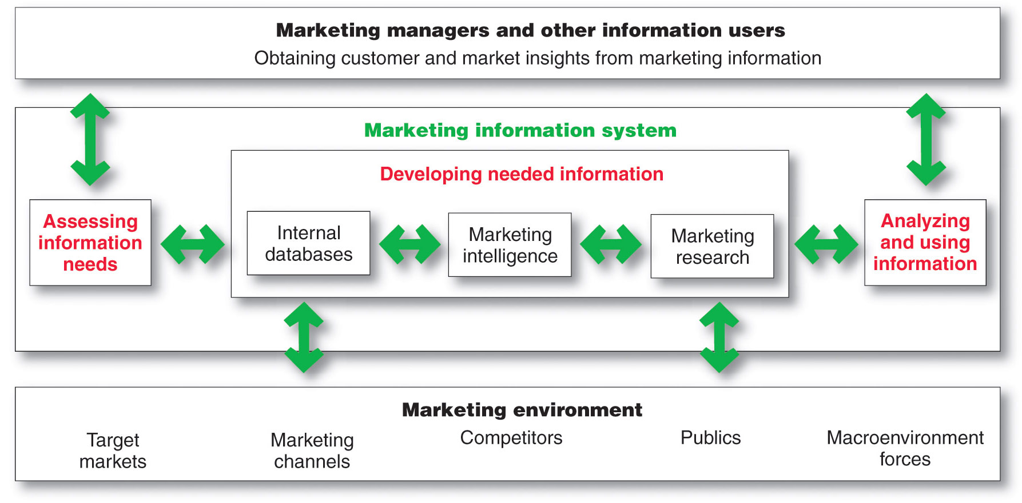
Marketing Information System

Slide 9
Assessing Marketing Information Needs
MIS provides information to the company’s marketing and other managers and external partners such as suppliers, resellers, and marketing service agencies

Slide 10
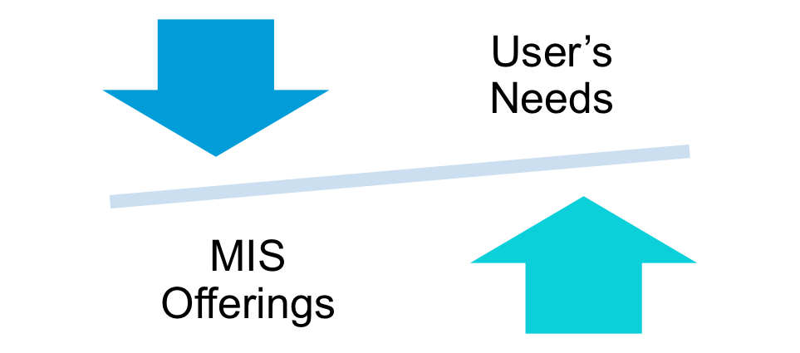
Assessing Marketing Information Needs
Characteristics of a Good MIS
Balancing what the information users would like to have against what they need and what is feasible to offer

Slide 11
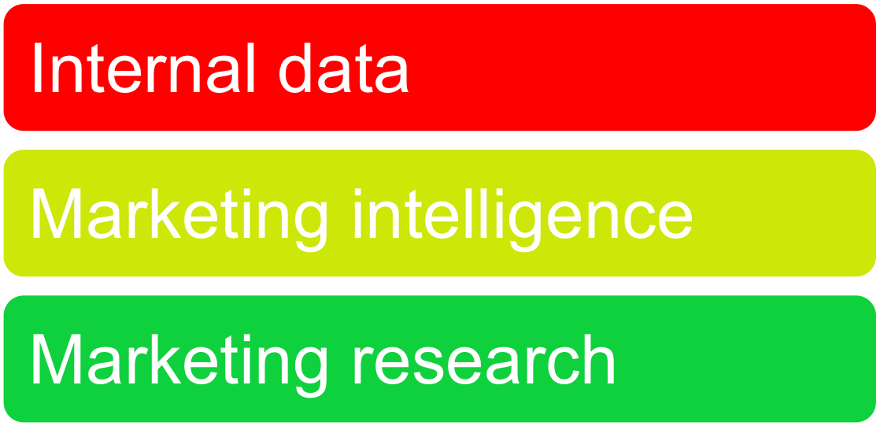
Developing Marketing Information
Marketers obtain information from

Slide 12

Developing Marketing Information
Internal Data
Internal databases are electronic collections of consumer and market information obtained from data sources within the company network
Notes:
Note to Instructor
Pizza Hut’s database is highlighted in the text. They have:
Detailed customer data on 40 million U.S. households, gleaned from phone orders, online orders, and point-of-sale transactions at its more than 7,500 restaurants.
The company can organize the data by order details to enhance customer relationships such as the Pizza Hut designed VIP (Very Into Pizza) program to retain its best customers. It invites these customers to join the VIP program for $14.95 and receive a free large pizza. Then, for every two pizzas ordered each month, VIP customers automatically earn a coupon for another free large pizza.

Slide 13
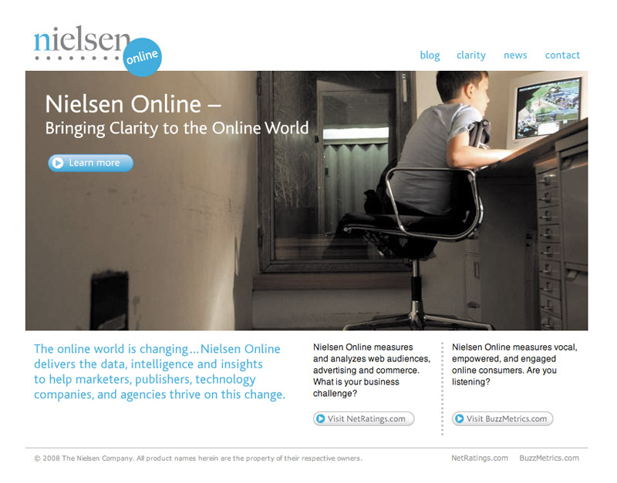

Developing Marketing Information
Marketing Intelligence
Marketing intelligence is the systematic collection and analysis of publicly available information about consumers, competitors and developments in the marketplace
Notes:
Note to Instructor
This Web link brings you to AC Nielsen’s homepage. This includes not just their online division but their entire company. It is very interesting to explore the area called trends an insights.
In slideshow view, click on movie icon to launch Meredith video snippet. See accompanying DVD for full video segment.
Discussion Question
Ask students what Nielsen might have learned about customers in these insights.

Slide 14

Developing Marketing Information
Marketing Research
Marketing research is the systematic design, collection, analysis, and reporting of data relevant to a specific marketing situation facing an organization

Slide 15
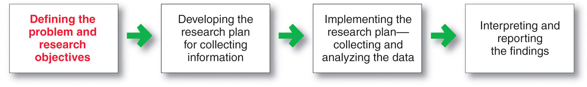
Developing Marketing Information
Steps in the Marketing Research Process

Slide 16
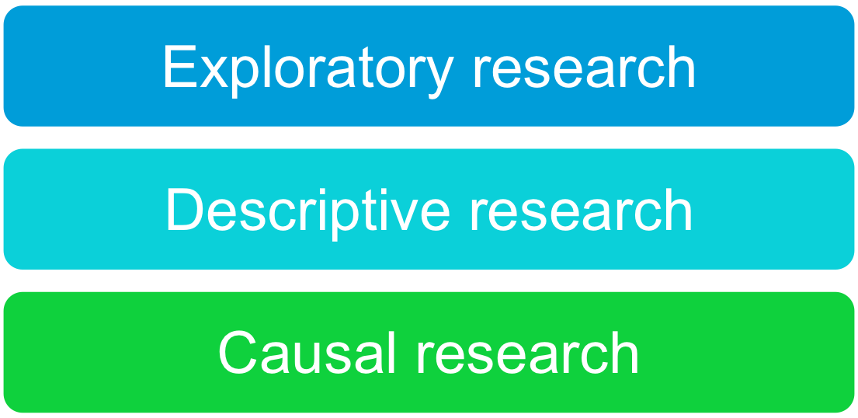
Developing Marketing Information
Marketing Research
Defining the Problem and Research Objectives
Notes:
Note to Instructor
These can be explained in more depth:
Exploratory research—objective is to gather preliminary information that will help define the problem and suggest hypotheses.
Descriptive research—describes things.
Causal research—tests hypothesis about cause and effect relationships.
Discussion Question
Consider a local business near campus. . .
How would they conduct exploratory research?
What might they want to find out in descriptive research?
What relationships might they explore in causal research?
Students will have the following responses for the above questions: exploratory research (focus groups, interviews); descriptive research (who, when, how, why);causal research (price/demand, environment/purchase rate).

Slide 17
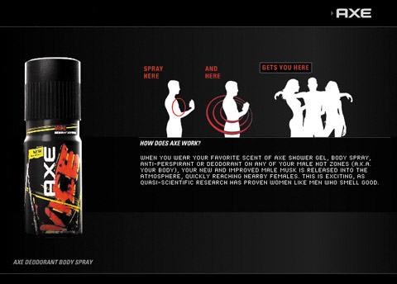
Developing Marketing Information
Marketing Research
Developing the Research Plan
Outlines sources of existing data
Spells out the specific research approaches, contact methods, sampling plans, and instruments to gather data
Notes:
Note to Instructor
The text gives an excellent example of Axe creating a line of cologne fragrances. The research plan might call for the following:
The demographic, economic, and lifestyle characteristics of current Axe users.
Characteristics and usage patterns of young male cologne users.
Retailer reactions to the proposed new product line.
Forecasts of sales of both the new and current Axe products.

Slide 18
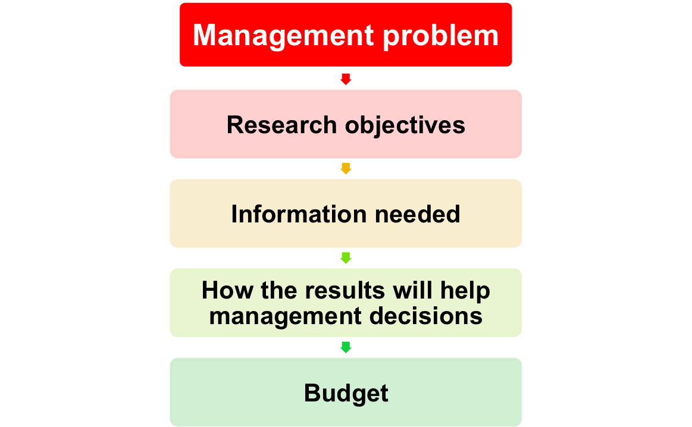
Developing Marketing Information
Marketing Research
Written Research Plan Includes:

Slide 19
Developing Marketing Information
Marketing Research
Developing the Research Plan
Secondary data consists of information that already exists somewhere, having been collected for another purpose
Primary data consists of information gathered for the special research plan

Slide 20
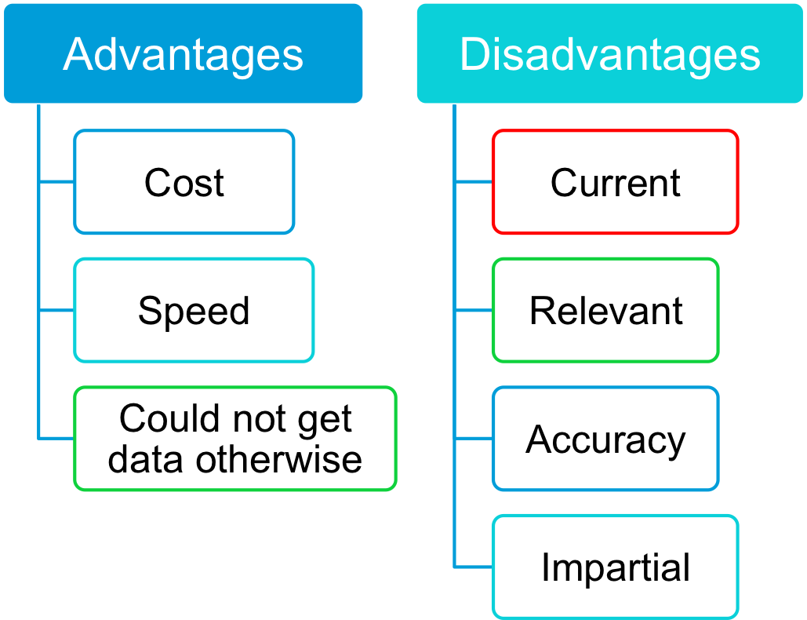
Developing Marketing Information

Slide 21
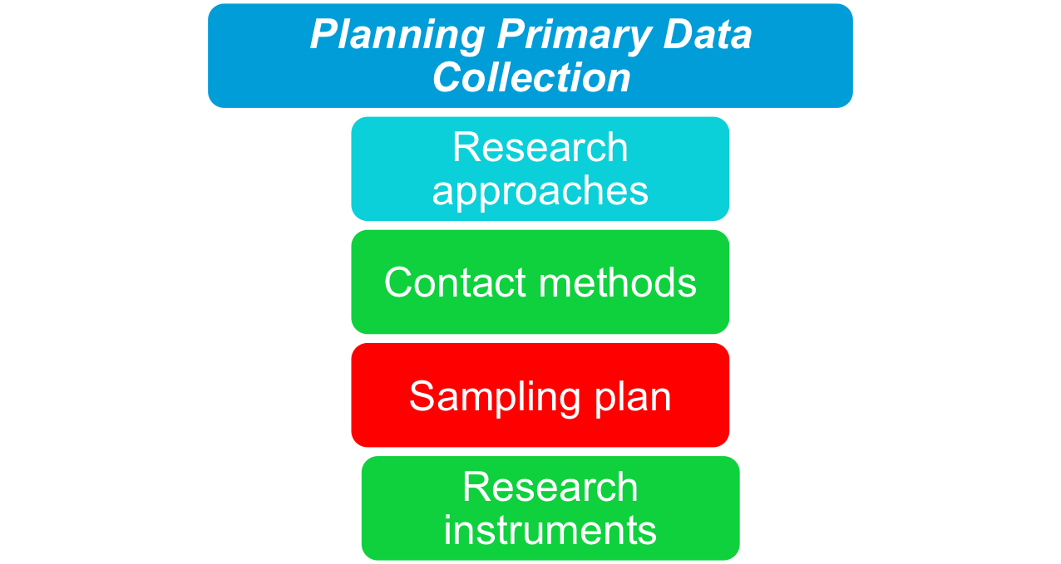
Developing Marketing Information
Marketing Research

Slide 22
MKTG 310
Stop Here

Slide 23
Developing Marketing Information
Market Research
Research Approaches
Observational research involves gathering primary data by observing relevant people, actions, and situations
Ethnographic research involves sending trained observers to watch and interact with consumers in their natural environment
Notes:
Note to Instructor
Discussion Question
Ask students how a company like Chiquita can use observational research for their banana sales.
Students should mention sending teams to stores to watch how people choose bananas, who purchases, who influences the sale, how many do they buy in a bunch, do they break a bunch, do they prefer green or ripe? How might the results influence Chiquita when marketing bananas (4P’s).

Slide 24
Developing Marketing Information
Market Research
Research Approaches
Survey research is the most widely used method and is best for descriptive information—knowledge, attitudes, preferences, and buying behavior
Flexible
People can be unable or unwilling to answer
Gives misleading or pleasing answers
Privacy concerns

Slide 25
Developing Marketing Information
Market Research
Research Approaches
Experimental research is best for gathering causal information—cause-and-effect relationships
Notes:
Note to Instructor
Discussion Question
Ask how a catalog marketer like Victoria’s Secret might run an experiment on a direct mail offer.
Students will realize they might change the copy, offer, envelope, and other parts of the direct mail piece.

Slide 26
Developing Marketing Information
Marketing Research Strengths and
Weakness of Contact Methods
 | Mail | Telephone | Personal | Online
Flexibility | Poor | Good | Excellent | Good
Quantity of data collected | Good | Fair | Excellent | Good
Control of interviewer effects | Excellent | Fair | Poor | Fair
Control of sample | Fair | Excellent | Good | Excellent
Speed of data collection | Poor | Excellent | Good | Excellent
Response rate | Poor | Poor | Good | Good
Cost | Good | Fair | Poor | Excellent

Slide 27

Developing Marketing Information
Marketing Research
Contact Methods
Focus Groups
  Six to 10 people with a trained moderator
  Challenges
    Expensive
    Difficult to generalize from small group
    Consumers not always open and honest
Notes:
Note to Instructor
Discussion Question
It is interesting to ask students if they have been participants in or worked as researchers on a professional focus group.
Ask them about the product, the other participants, and the results the researcher obtained. Ask them to put themselves in the role of the moderator and ask them what problems they might have when running the focus group.
A partial list might include:
Over-participants
Quiet participants
Keeping the group on track
Meeting the needs of the client

Slide 28
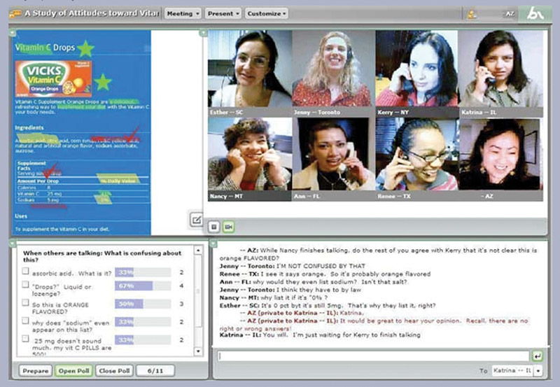
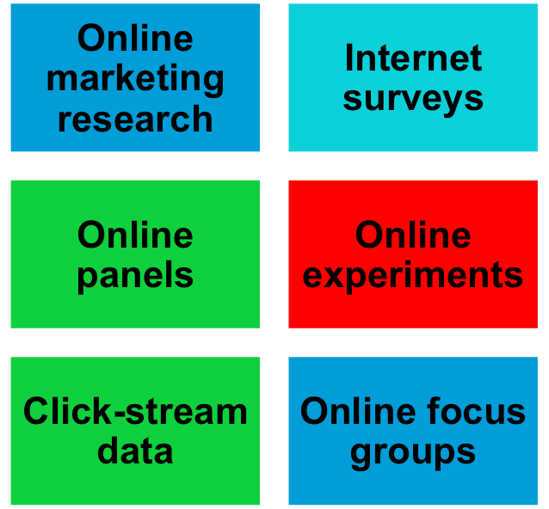
Developing Marketing Information
Marketing Research
Contact Methods

Slide 29
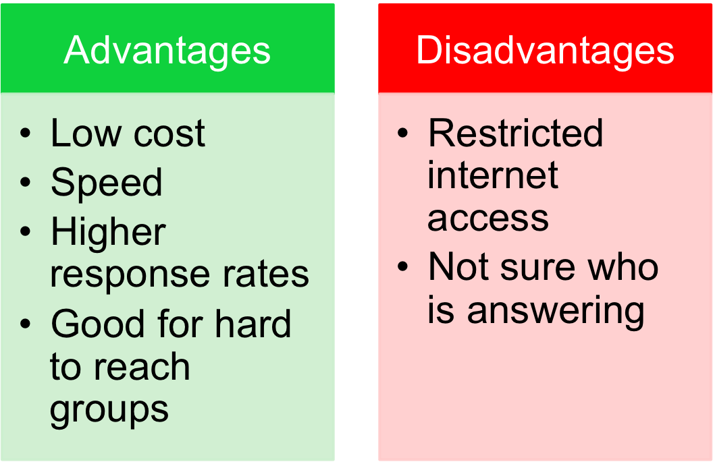
Developing Marketing Information
Marketing Research
Online Research

Slide 30
Developing Marketing Information
Marketing Research
Sampling Plan
Sample is a segment of the population selected for marketing research to represent the population as a whole
  Who is to be surveyed?
  How many people should be surveyed?
  How should the people be chosen?

Slide 31
Developing Marketing Information
Marketing Research
Sampling Plan – Types of Samples
Probability Sample
Simple random sample | Every member of the population has a known and equal chance of selection
Stratified random sample | The population is divided into mutually exclusive groups and random samples are drawn from each group
Cluster (area) sample | The population is divided into mutually exclusive groups and the researcher draws a sample
Nonprobability Sample
Convenience sample | The research selects the easiest population members
Judgment sample | The researcher uses their judgment to select population members
Quota sample | The researcher finds and interviews a prescribed number of people in each of several categories

Slide 32
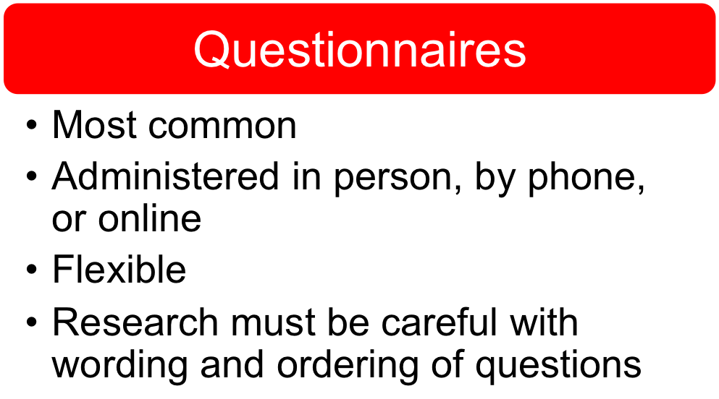
Developing Marketing Information
Marketing Research
Research Instruments

Slide 33
Developing Marketing Information
Marketing Research
Research Instruments—Questionnaires
Closed-end questions include all possible answers, and subjects make choices among them
  Provide answers that are easier to interpret and tabulate
Open-end questions allow respondents to answer in their own words
  Useful in exploratory research
Notes:
Note to Instructor
Discussion Question
Ask students the disadvantages with open-ended questions.
They might realize from their own experience that they get tired filling out many open ended questions and that they often lead to hard-to-code information.

Slide 34
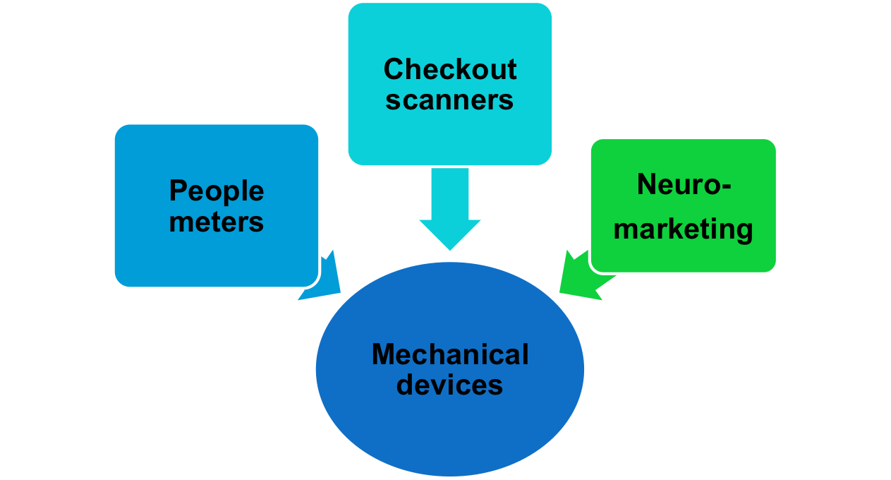
Developing Marketing Information
Marketing Research
Research Instruments
Notes:
Note to Instructor
Students are naturally intrigued by neuromarketing. Through MRI scans scientists have learned that message trigger certain areas in the brain. The book gives an example for neuromarketing as follows:
Bathroom cleaner users watched a commercial for Unilever’s Vim line of home cleaners, positioned as a product that “deals with the toughest dirt. In all, the ad stirred up very strong, mostly negative emotions. Follow-up interviews showed that consumers actually hated the ad. How did researchers measure viewers’ response to such emotionally charged advertising? Six electrodes attached to each person’s head after which they were asked how they felt about the ad.

Slide 35
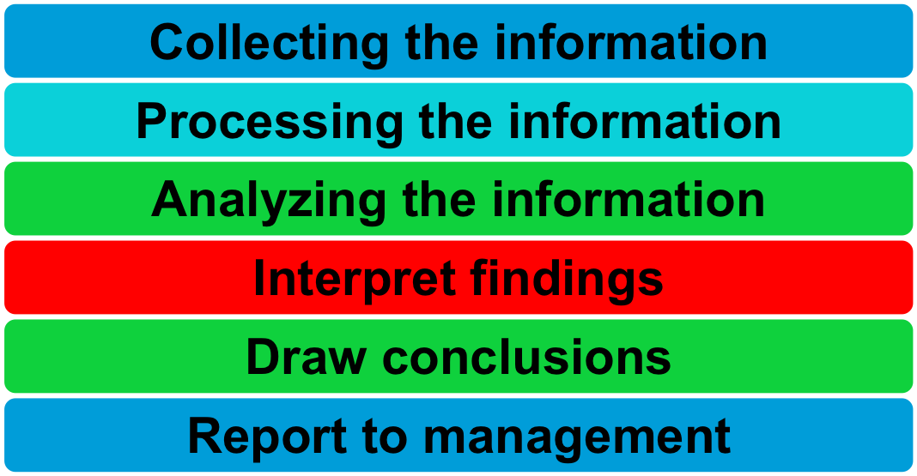
Developing Marketing Information
Marketing Research
Implementing the Research Plan

Slide 36
Analyzing and Using Marketing Information
Customer Relationship Management (CRM)
CRM consists of sophisticated software and analytical tools that integrate customer information from all sources, analyze it in depth, and apply the results to build stronger customer relationships

Slide 37
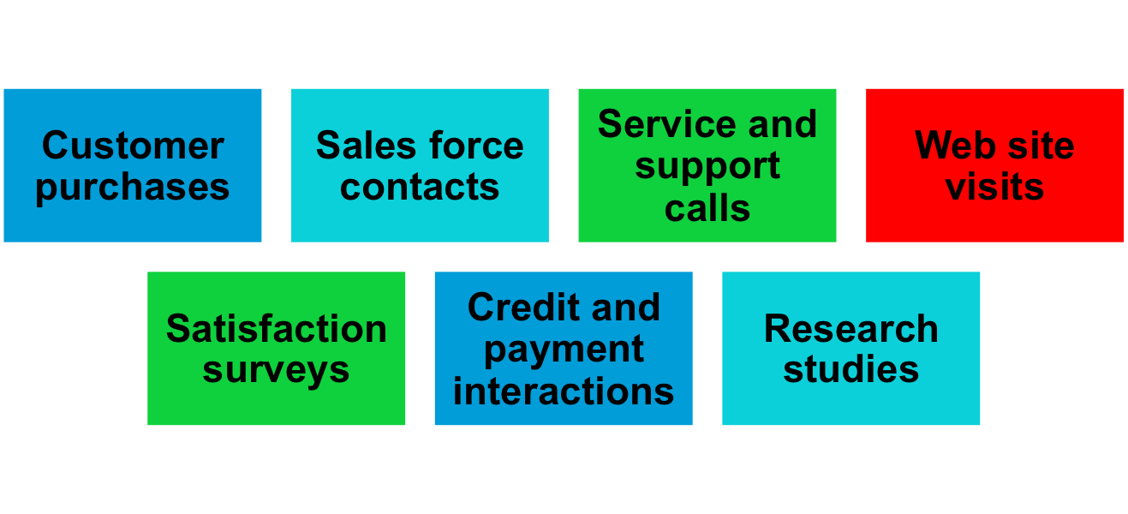
Analyzing and Using Marketing Information
Customer Relationship Management
Touchpoints

Slide 38
Distributing and Using Marketing Information
Information distribution involves entering information into databases and making it available in a time-useable manner
Intranet provides information to employees and other stakeholders
Extranet provides information to key customers and suppliers

Slide 39
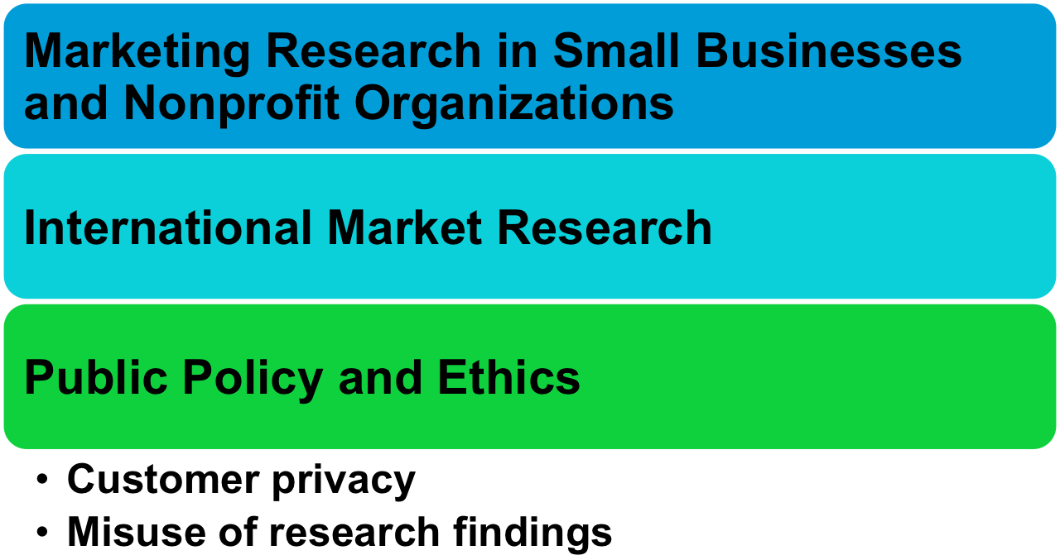
Other Marketing Information Considerations
Notes:
Note to Instructor
Discussion Questions
How do you feel about your privacy with online, phone, in-person, or mail surveys? Are some better than others? When might the questions feel like an Invasion of privacy or fraud.
Students will mention problems with privacy (health) or fraud (financial questions). They might not mind online as much as telephone research.

Slide 40
Chapter Five
Consumer Markets and Consumer Buyer Behavior

Slide 41
Preview of Chapter 5
Model of Consumer Behavior
Characteristics Affecting Consumer Behavior
Types of Buying Decision Behavior
The Buyer Decision Process
The Buyer Decision Process for New Products

Slide 42
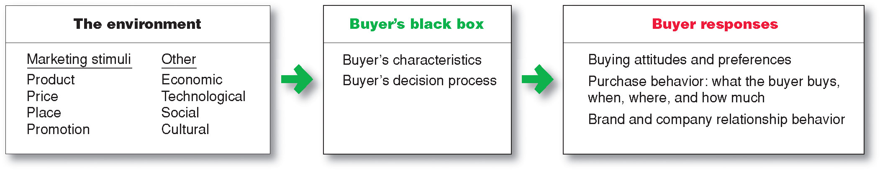

Model of Consumer Behavior
Notes:
Note to Instructor
It is interesting to talk about the buyer’s black box and one of the largest challenges in marketing is to understand what happens in this black box. Students will enjoy this video by Derren Brown. It is unclear how he obtains his results and how scientific this is, but it will certainly have students realize the mystery of the consumer’s brain.

Slide 43
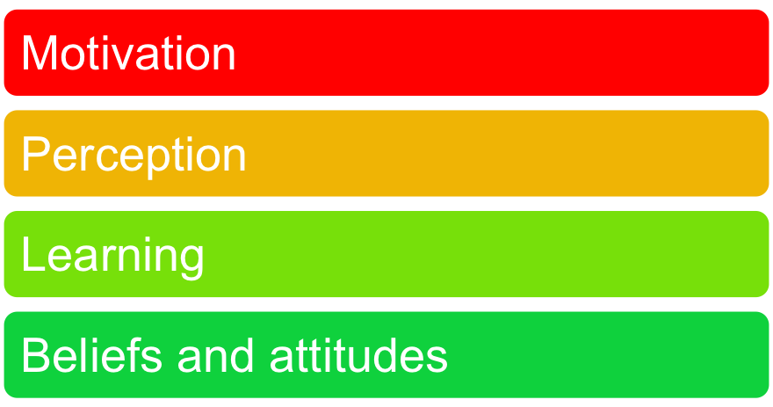

Characteristics Affecting Consumer Behavior
Psychological Factors

Slide 44
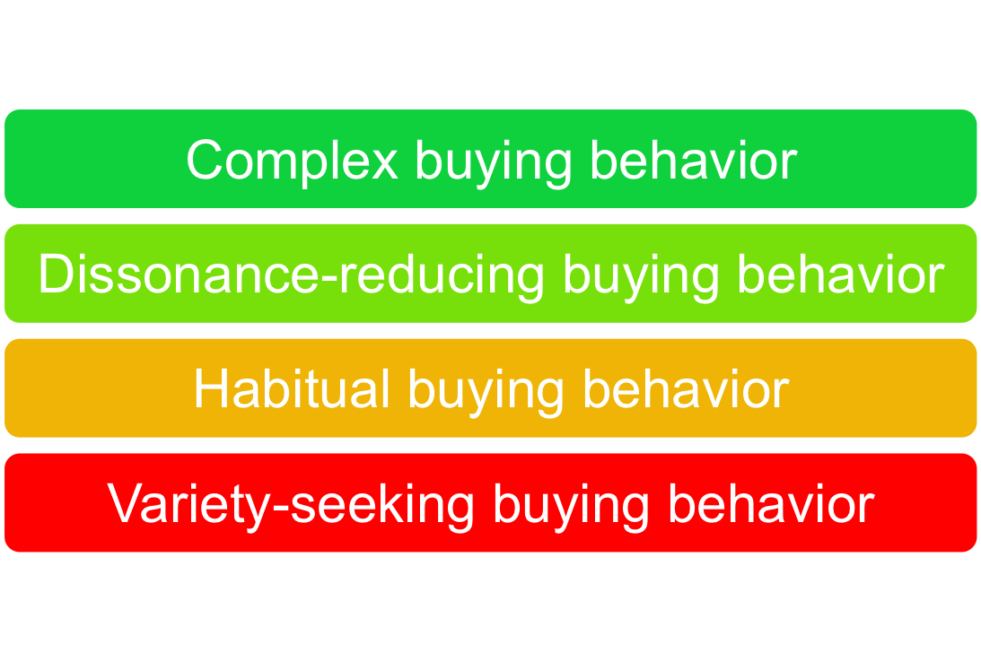
Types of Buying Decision Behavior

Slide 45
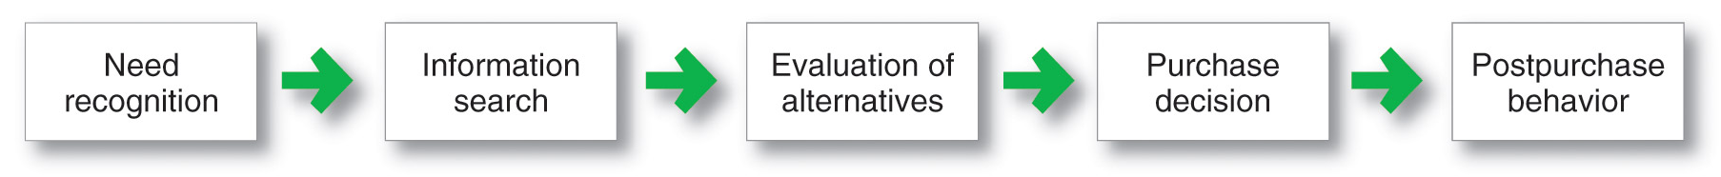
The Buyer Decision Process
Buyer Decision Making Process

Slide 46
Preview Chapter 5

Slide 47
Consumer Markets and Consumer Buyer Behavior
Model of Consumer Behavior
Characteristics Affecting Consumer Behavior
Types of Buying Decision Behavior
The Buyer Decision Process
The Buyer Decision Process for New Products

Slide 48
MKTG 310
See You Next Class!

Slide 49
Today’s Class Overview
Review Chapter 3
Marketing Info and Customer Insights (Chapter 4)
Preview for Next Class

Slide 50
Review of Last Class…

